Slide 1
NEW WHEELS DATA REPORT
SQL PROJECT
By:
VIDYA V
PGPBSBA.O.2023.B
07.10.2023

Slide 2
BUSINESS METRICS

Slide 3
BUSINESS OVERVIEW
1000
Total Orders
994
Total Customers
$125 M
Total Revenue
199
Last Qtr Orders
54
Vehicle
Makers
49
States
$23 M
Last Qtr Revenue
504
Vehicle Models

Slide 4
CUSTOMER METRICS

Slide 5
Customer State-wise Distribution
OBSERVATIONS:
Good presence in the states of New York and California, with 97 customers each, out of total customers
Least presence in Vermont, Wyoming and Maine

Slide 6
Quarter-wise Average Ratings
OBSERVATIONS:
For determining the ratings, the following key was used:
Very Bad is 1
Bad is 2
Okay is 3
Good is 4
Very Good is 5
As seen here, the ratings have declined steadily through the four quarters

Slide 7
Quarter-wise Customer Feedback
OBSERVATIONS:
Quarter 1 started with good feedback, with 59% rating good or above, and 19% with okay rating. Only 22% of the feedbacks were negative
However, there is a steady decline in positive feedbacks in subsequent quarters
The fourth quarter had the worst feedbacks from customers, with 60% rating bad or very bad and only 20% of the customers rated good or very good

Slide 8
VEHICLE METRICS

Slide 9
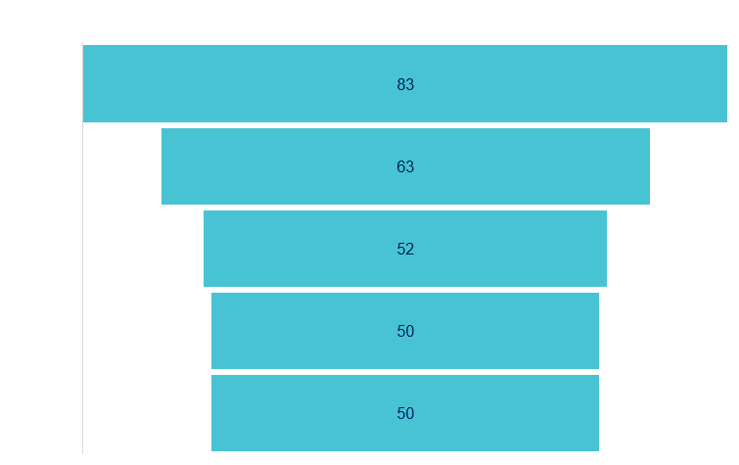
Top 5 Vehicle Makers preferred
OBSERVATIONS:
Chevrolet is the most preferred maker, with 83 orders, followed by Ford with 63 orders

Slide 10
State-wise Vehicle Maker Preference
State | Preferred Maker
Alabama | Dodge
Alaska | Chevrolet
Arizona | Cadillac, Pontiac
Arkansas | Chevrolet, GMC, Mitsubishi, Pontiac, Suzuki, Volkswagen
California | Audi, Chevrolet, Dodge, Ford, Nissan
Colorado | Chevrolet
Connecticut | Chevrolet, Maserati, Mercury, Volvo
Delaware | Mitsubishi
District of Columbia | Chevrolet
Florida | Toyota
Georgia | Toyota
Hawaii | Cadillac, Ford, GMC, Nissan Pontiac, Toyota
Idaho | Dodge
Illinois | Chevrolet, GMC, Ford
Indiana | Mazda
Iowa | Chevrolet, Chrysler, Dodge, Ford, Hyundai, Isuzu, Jeep Mazda, Pontiac, Porsche, Subaru
State | Preferred Maker
Kansas | Buick, Dodge, Ford, GMC, Honda, Lexus, Maserati, Mazda Mercedes-Benz, Nissan, Saab, Suzuki, Volkswagen
Kentucky | Acura, Audi, Mercedes-Benz, Mercury, Nissan, Pontiac, Ram Volvo
Louisiana | Nissan, BMW, Ford, Pontiac, Kia
Maine | Mercedes-Benz
Maryland | Ford
Massachusetts | Dodge, Chevrolet
Michigan | Ford
Minnesota | GMC
Mississippi | Dodge, Toyota
Missouri | Chevrolet
Montana | Chevrolet, Dodge, Mitsubishi
Nebraska | Cadillac, Chevrolet, Mercedes-Benz, Nissan, Pontiac, Toyota Volkswagen
Nevada | Pontiac
New Hampshire | Chrysler, Lexus, Lincoln
New Jersey | Hyundai, Mercedes-Benz
New Mexico | Dodge
State | Preferred Maker
New York | Toyota, Pontiac
North Carolina | Volvo
North Dakota | Ford, Hyundai
Ohio | Chevrolet
Oklahoma | Ferrari, Mazda, Toyota
Oregon | Toyota
Pennsylvania | Toyota
South Carolina | Acura, BMW, Buick, Dodge, Isuzu, Jaguar, Kia, Mazda Mitsubishi
Tennessee | Mazda
Texas | Chevrolet
Utah | Buick, Chevrolet, Dodge, Isuzu, Lincoln, Maybach, Oldsmobile, Pontiac, Subaru, Volkswagen
Vermont | Mazda
Virginia | Ford
Washington | Chevrolet
West Virginia | Mercedes-Benz
Wisconsin | Acura, Cadillac, Chevrolet, Dodge, Honda, Mazda, Nissan Pontiac
Wyoming | Buick

Slide 11
REVENUE METRICS

Slide 12
Quarter-wise Orders
OBSERVATIONS:
There is a steady decline in the total number of orders every quarter

Slide 13
QoQ Revenue Movement
OBSERVATIONS:
Q2 performance showed a sharp decline in revenue
Q3 showed some signs of recovery, only to end in Q4 performance in revenue being the lowest

Slide 14
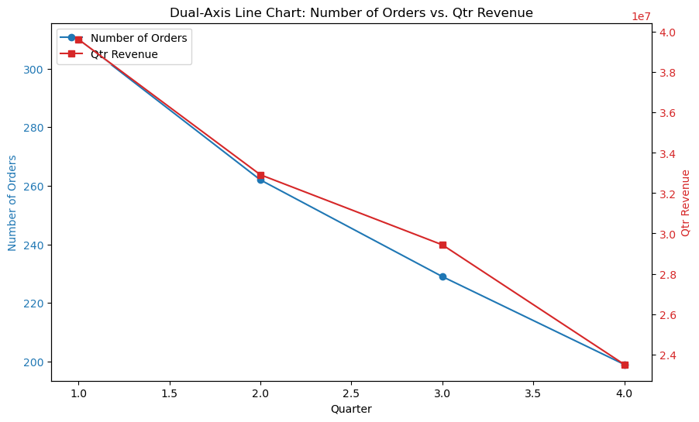
QoQ Revenue and Orders Comparison
OBSERVATIONS:
While the number of orders has a steady decline, the revenue drop seems to have lessened in Q3
However, in Q4, both sales and revenue have declined.

Slide 15
SHIPPING METRICS

Slide 16
Card Types and Average Discount
OBSERVATIONS:
Diners-club-international card has the least discount of 58.4%
Laser card has the highest discount of 64.4%

Slide 17
QoQ Average Time to Ship
OBSERVATIONS:
The average time to ship orders went from 57 in Q1 to 174 in Q4

Slide 18
INSIGHTS AND RECOMMENDATIONS

Slide 19





Content Title
Company presence based marketing strategies
The presence of the company is strongly felt through high number of orders in states like Texas and California
However, in states like Wyoming, Vermont and Maine, there have not been many.
Developing different marketing strategies based on the presence can be done
Focus on preferred models and makers
Targeted pitching of preferred models might help improve revenue
Non-preferred models might need to be removed from sales
Address Shipping Delays
There is a significant difference in the number of days to ship for customers with different ratings
Customers with high shipping days have rated poorly
Discount based customer addition
Increasing the discount offered might help increase the number of orders
Feedback based model sales
Certain models like Citron, Daevoo, Eagle have not had any positive feedback
Whereas, makes like Volvo, Mazda have had a high positive feedback. These can be focused for sales

Slide 20
Thank You

